Slide 1
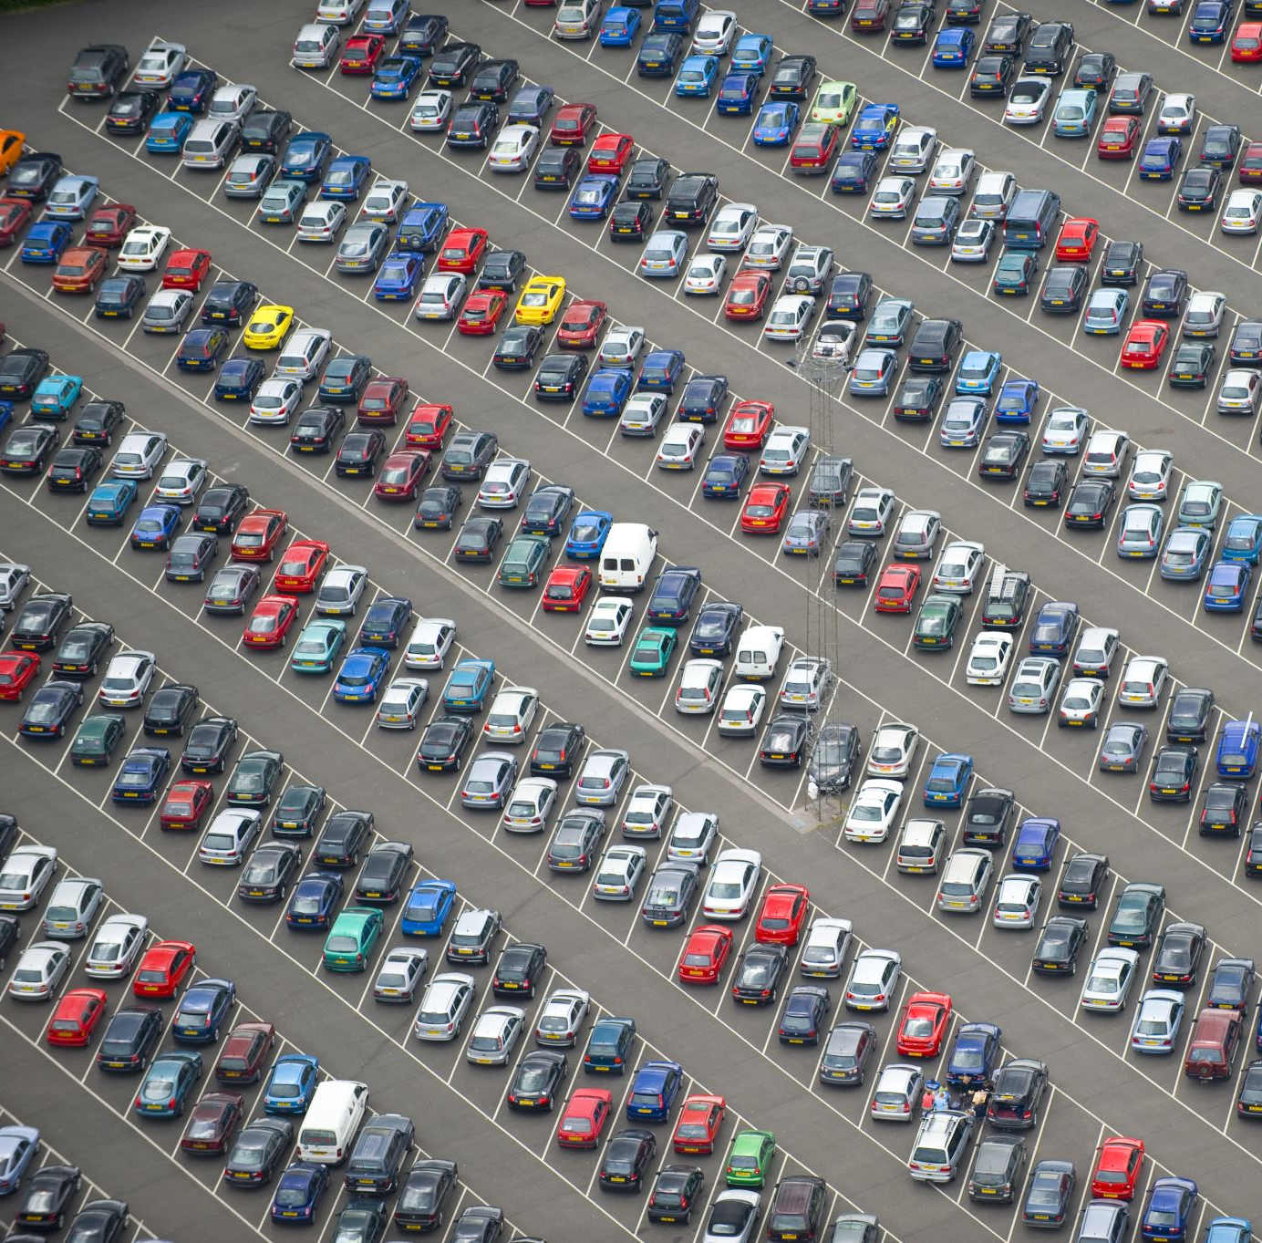
VEHICLE MANAGEMENT SYSTEM
• Deep Anand Vaidya – 001099996 • Noordeep Gill – 002194664 • Sai Swarna Raghuraman – 002191782 • Sethu Surya Teja Pagolu – 002122149 • Vivek Mannava – 002921511 • Yash Jain – 001521876

Slide 2
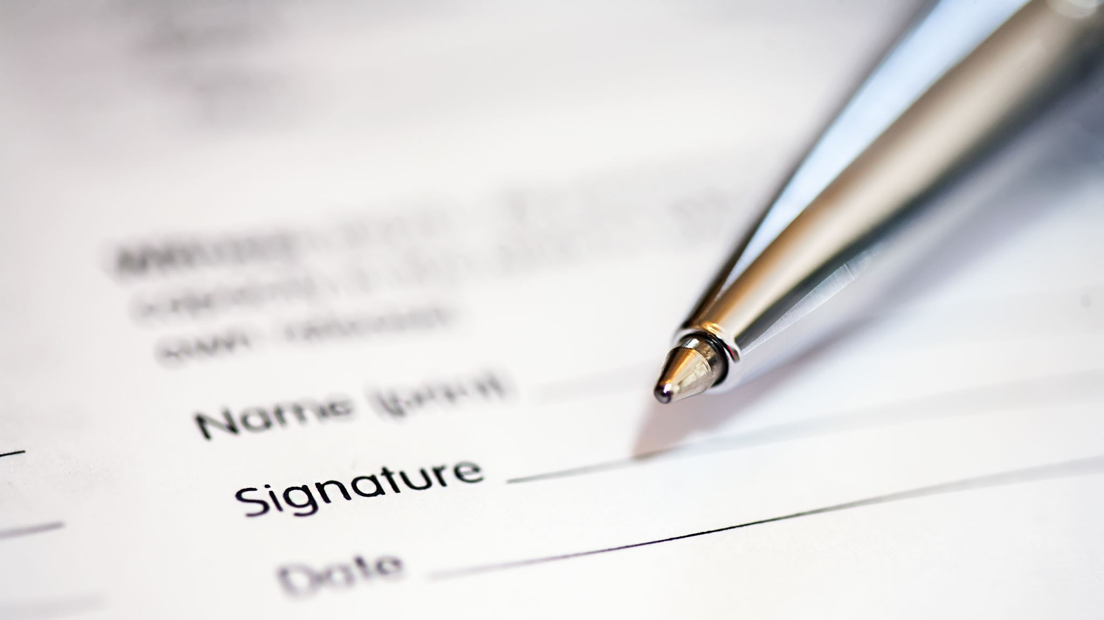
PROBLEM STATEMENT

Slide 3
Multiple users sign in with the same username and it’s difficult to manually search them for existing users. This causes data inconsistencies.
It’s important to track whether a vehicle has been dropped to its destination by the allotted time. This is useful since it can avoid any last-minute confusion when the vehicle is assigned to a new customer. Manage the locations where the cars can be parked and manage the parking spaces allocated at each location.
This data can be used to increase/decrease the parking capacity in the future.
Demand of car in each city or location. Total amount of money earned, and which area is profitable and highest demand to increase the service.
In case a user exceeds the allotted time-limit or exceeds the max distance, an additional charge will be incurred to the user.

Slide 4

Solution

Slide 5
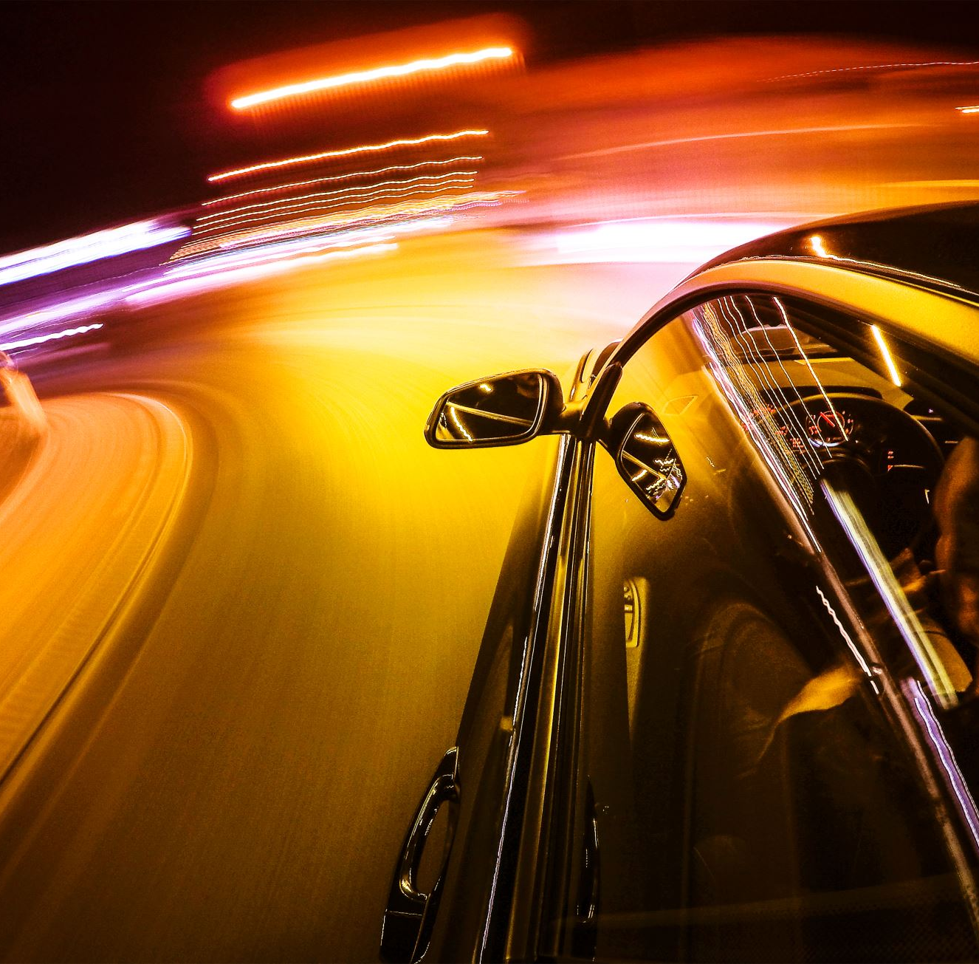
Users should be able to login/register.
Users should be able to find the nearest pickup point based on the pin code provided.
Users should be able to view cars.
Users should be able to filter out cars based on the user needs.
Users should be able to book the car.
Users should be given an alert an hour before the deadline.
Users should be able to extend the time duration of the booking later.

Slide 6
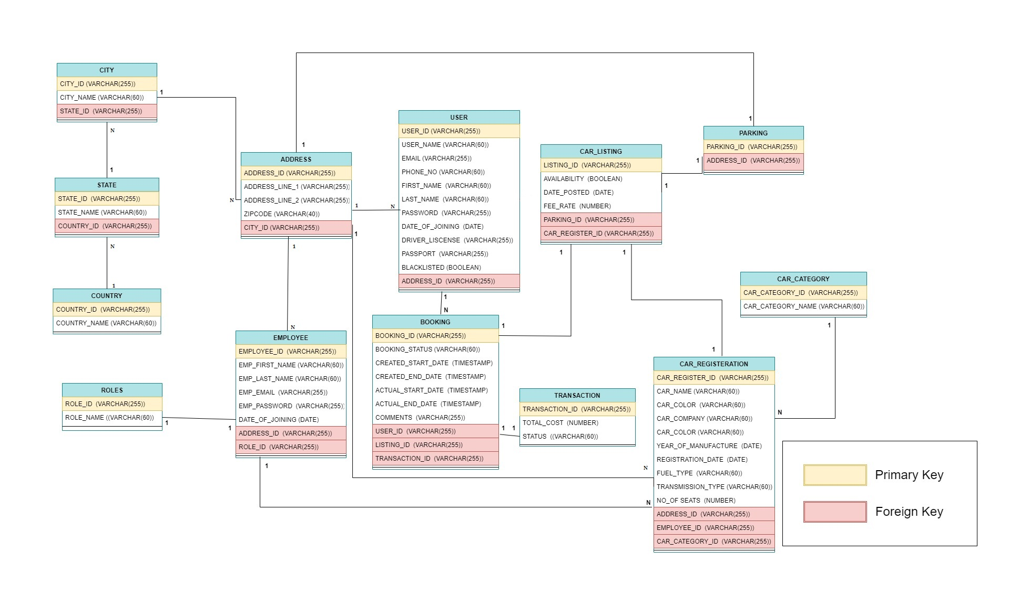

Slide 7
Contributions
Deep Anand Vaidya worked on Booking and Address tables
Yash Jain worked on Transaction and car registration tables and reports
Vivek worked on User table and PPT.
Noordeep worked on country,state,city, user tables and reports
Sethu worked on CarListing,Parking,CarCategory tables
Swarna worked on Employment table

Slide 8

THANK YOU

